Slide 1
Chapter 7: Synchronization Examples

Slide 2
Classical Problems of Synchronization
Classical problems used to test synchronization schemes
  Bounded-Buffer Problem
  Readers and Writers Problem
  Dining-Philosophers Problem

Slide 3
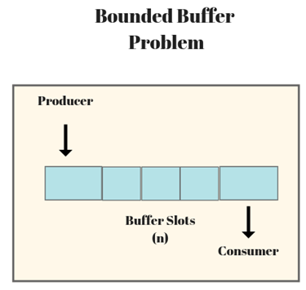
Bounded-Buffer Problem
n buffers, each can hold one item
Semaphore mutex initialized to the value 1
Semaphore full initialized to the value 0
Semaphore empty initialized to the value n

Slide 4
Bounded Buffer Problem (Cont.)
The structure of the producer process
while (true) {
...
/* produce an item in next_produced */
...
wait(empty);
wait(mutex);
...
/* add next produced to the buffer */
...
signal(mutex);
signal(full);
}

Slide 5
Bounded Buffer Problem (Cont.)
The structure of the consumer process
while (true) {
wait(full);
wait(mutex);
...
/* remove an item from buffer to next_consumed */
...
signal(mutex);
signal(empty);
...
/* consume the item in next consumed */
...
}

Slide 6
Readers-Writers Problem
A data set is shared among a number of concurrent processes
  Readers – only read the data set; they do not perform any updates
  Writers – can both read and write
Problem – allow multiple readers to read at the same time
  Only one single writer can access the shared data at the same time
Several variations of how readers and writers are considered – all involve some form of priorities
Shared Data
  Data set
  Semaphore rw_mutex initialized to 1
  Semaphore mutex initialized to 1
  Integer read_count initialized to 0

Slide 7
Readers-Writers Problem (Cont.)
The structure of a writer process
while (true) {
wait(rw_mutex);
...
/* writing is performed */
...
signal(rw_mutex);
}

Slide 8
Readers-Writers Problem (Cont.)
The structure of a reader process
while (true){
wait(mutex);
read_count++;
if (read_count == 1) //first reader grabs lock
wait(rw_mutex);
signal(mutex);
/* reading is performed */
...
wait(mutex);
read count--;
if (read_count == 0) //last reader gives up lock
signal(rw_mutex);
signal(mutex);
}

Slide 9
Readers-Writers Problem Variations
First variation – no reader kept waiting unless writer has permission to use shared object
  Readers may block writers
Second variation – once writer is ready, it performs the write ASAP
  Writers may block readers
Both may have starvation
Problem is solved on some systems by kernel providing reader-writer locks, which are most useful when
  it is easy to reader processes and writers
  there are more readers than writers

Slide 10

Dining-Philosophers Problem
Philosophers spend their lives alternating thinking and eating
Don’t interact with their neighbors, occasionally try to pick up 2 chopsticks (one at a time) to eat from bowl
  Need both chopsticks to eat, then release both when done

Slide 11
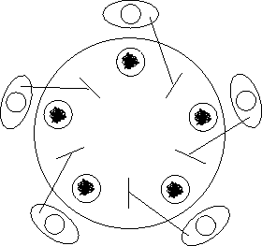
Dining-Philosophers Problem Algorithm
Semaphore Solution: Semaphore chopstick [5] initialized to 1
The structure of Philosopher i:
    while (true){
    wait (chopstick[i] );
    wait (chopStick[ (i + 1) % 5] );
    /* eat for a while */
    signal (chopstick[i] );
    signal (chopstick[ (i + 1) % 5] );
    /* think for a while */
    }
What is the problem with this algorithm?
  Deadlock!

Slide 12
Several Remedies
Allow at most four philosophers to be sitting simultaneously at the table
Allow a philosopher to pick up her chopsticks only if both chopsticks are available (to do this, she must pick them up in a critical section).
Use an asymmetric solution—that is, an odd-numbered philosopher picks up first her left chopstick and then her right chopstick, whereas an even numbered philosopher picks up her right chopstick and then her left chopstick.

Slide 13
Monitor Solution to Dining Philosophers
monitor DiningPhilosophers {
enum { THINKING; HUNGRY, EATING) state [5] ;
condition mayEat[5]; //self[5] in OSC textbook
void pickup (int i) {
state[i] = HUNGRY;
//to activate i: set state to eating only if my left
//and right neighbors are not eating
test(i);
//if unable to eat, wait to be signaled
if (state[i] != EATING)
mayEat[i].wait();
}
void putdown (int i) {
state[i] = THINKING;
// if left neighbor is hungry and its two
// neighbors are not eating, set it to eating
// and wake it up by signal
test((i + 4) % 5);
test((i + 1) % 5);
}

Slide 14
Solution to Dining Philosophers (Cont.)
void test (int i) { //update state
if ((state[(i + 4) % 5] != EATING) &&
(state[i] == HUNGRY) &&
(state[(i + 1) % 5] != EATING) ) {
state[i] = EATING ; //indicate I’m eating
//signal() has no effect during pickup(), but is
//important to wake up waiting hungry
//philosophers during putdown()
mayEat[i].signal() ;
}
}
initialization_code() {
for (int i = 0; i < 5; i++)
state[i] = THINKING;
}
}

Slide 15
The Javadoc for signal says "If any threads are waiting on this condition then one is selected for waking up."
The Javadoc for signal says "If any threads are waiting on this condition then one is selected for waking up."
Solution to Dining Philosophers (Cont.)
Each philosopher i invokes the operations pickup() and putdown() in the following sequence:
DiningPhilosophers.pickup(i);
/** EAT **/
DiningPhilosophers.putdown(i);
No deadlock, but starvation is possible
  because signal() is not fair: it wakes up any of the waiting threads (philosophers) at random and might thus not wake up a certain thread for an arbitrary long time.
  E.g., Javadoc says “If any threads are waiting on this condition then one is selected for waking up” – choice is arbitrary

Slide 16
Linux Synchronization
Linux:
  Prior to kernel Version 2.6, disables interrupts to implement short critical sections
  Version 2.6 and later, fully preemptive
Linux provides:
  Semaphores
  atomic integers
  spinlocks
  reader-writer versions of both
On single-cpu system, spinlocks replaced by enabling and disabling kernel preemption

Slide 17
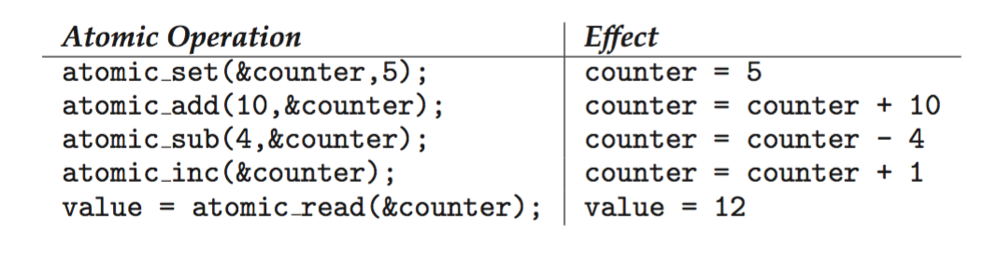
Linux Synchronization
Atomic variables
atomic_t is the type for atomic integer
Consider the variables
atomic_t counter;
int value;

Slide 18
POSIX Synchronization
POSIX API provides
  mutex locks
  semaphores
  condition variable
Widely used on UNIX, Linux, and macOS

Slide 19
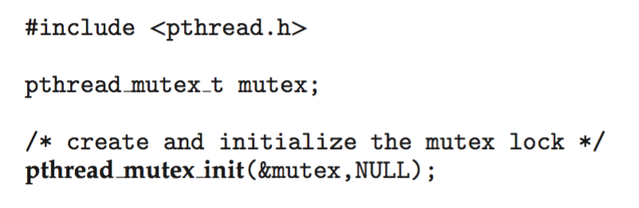
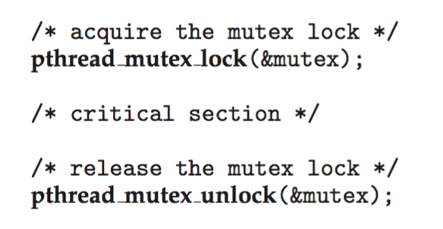
POSIX Mutex Locks
Creating and initializing the lock
Acquiring and releasing the lock

Slide 20
POSIX Semaphores
POSIX provides two versions – named and unnamed.
Named semaphores can be used by unrelated processes, unnamed cannot.

Slide 21
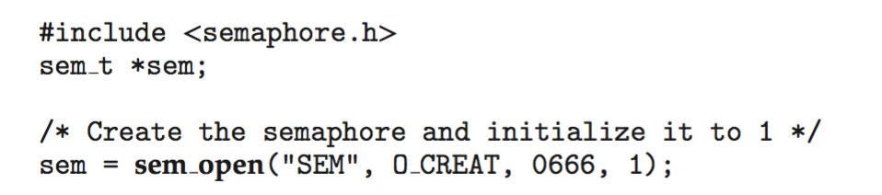
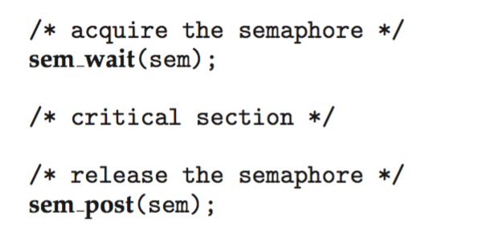
POSIX Named Semaphores
Creating an initializing the semaphore:
Another process can access the semaphore by referring SEM.
Acquiring and releasing the semaphore:

Slide 22
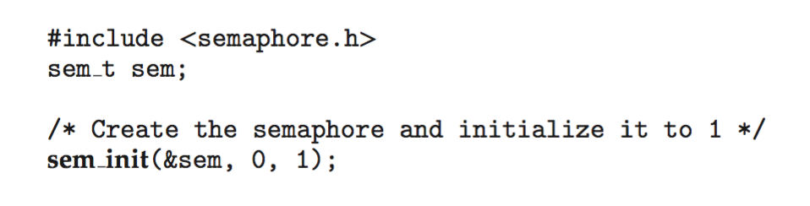
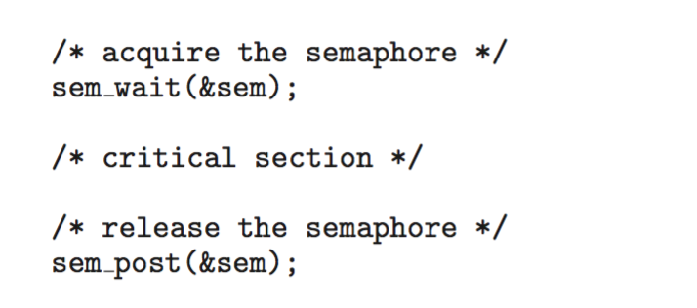
POSIX Unnamed Semaphores
Creating an initializing the semaphore:
Acquiring and releasing the semaphore:

Slide 23
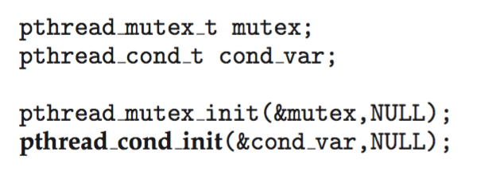
POSIX Condition Variables
Since POSIX is typically used in C/C++ and these languages do not provide a monitor, POSIX condition variables are associated with a POSIX mutex lock to provide mutual exclusion
Creating and initializing the condition variable:

Slide 24
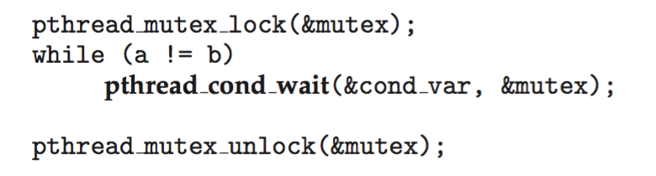
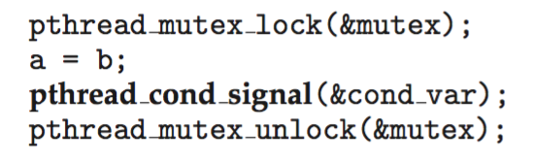
POSIX Condition Variables
Thread waiting for the condition a == b to become true.
Thread signaling another thread waiting on the condition variable:
must be locked first, since it is used to protect the a and b
Release mutex here. Function returns when signaled and another thread releases mutex

Slide 25
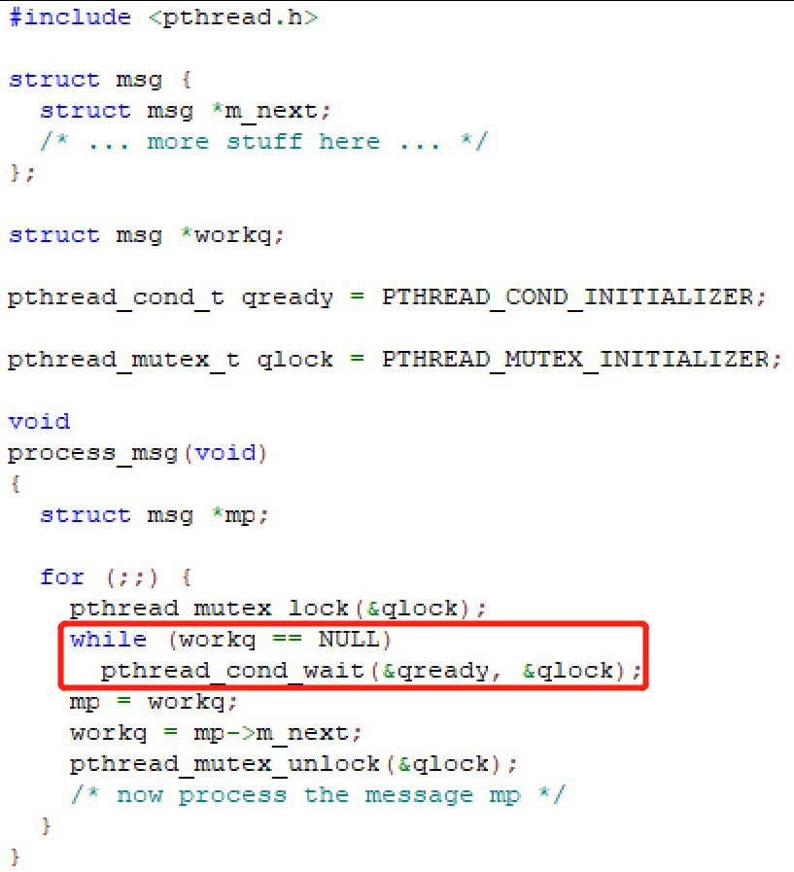
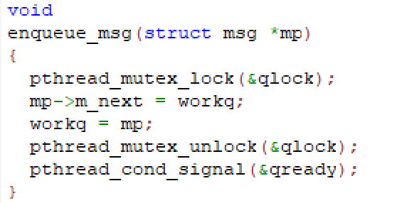
An example of pthread_cond_wait
From APUE 3e
process_msg() : process messages from a queue workq
enqueue_msg() : put a new message *mp into the queue

Slide 26
Advanced Sync functions in pthread (APUE 3e)
pthread_mutex_timedlock
  bound the time that a thread blocks when a mutex it is trying to acquire is already locked.
Reader–writer locks
  similar to mutexes, except that they allow for higher degrees of parallelism
  Three states: locked in read mode, locked in write mode, and unlocked.
  also called shared–exclusive locks
Reader–Writer Locking with Timeouts

Slide 27
Alternative Approaches
Transactional Memory
OpenMP
Functional Programming Languages

Slide 28
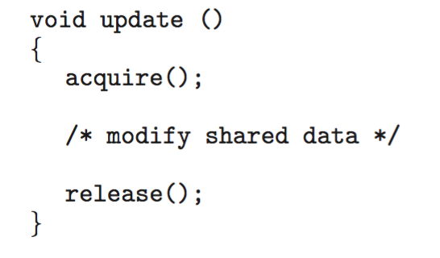
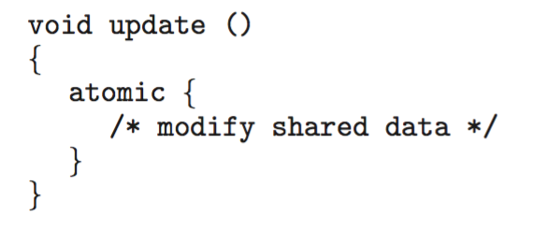
Transactional Memory
Consider a function update() that must be called atomically. One option is to use mutex locks:
A memory transaction is a sequence of read-write operations to memory that are performed atomically. A transaction can be completed by adding atomic{S} which ensure statements in S are executed atomically:

Slide 29
OpenMP
OpenMP is a set of compiler directives and API that support parallel progamming.
void update(int value)
{
#pragma omp critical
{
count += value
}
}
The code contained within the #pragma omp critical directive is treated as a critical section and performed atomically.

Slide 30
Functional Programming Languages
Functional programming languages offer a different paradigm than procedural languages in that they do not maintain state.
Variables are treated as immutable and cannot change state once they have been assigned a value.
There is increasing interest in functional languages such as Erlang and Scala for their approach in handling data races.

Slide 31
Homework: Programming Projects
OSC Projects
  Project 1—Designing a Thread Pool
  Project 3—The Dining-Philosophers Problem
  Project 4—The Producer – Consumer Problem
Linux Kernel Project 1: Compile Linux Kernel on VirtualBox
  Enlarge virtualbox disk space, see guidance from https://linuxhint.com/increase-virtualbox-disk-size/; also increase memory to 2GB in VirtualBox setting
  Retrieve Linux source with sudo apt-cache search Linux-source and sudo apt install Linux-source-xxx
  Enter source tree, remove irrelevant device drivers during make menuconfig, and then make; make install; make modules_install;

Slide 32
End of Chapter 7

